Slide 1
TECHNICAL ANALYSIS SCREENER_2 HEIKIN ASHI

Slide 2
GROUP MEMBERS
Baradi Bindhu
Bana Vijaya Lakshmi
Uppu Nimeesha
Remala Venkata Laxmi Nikhila
Rontala Ruchitha

Slide 3
PROJECT TIME LINE
SRS Release
Code Implementation
Integration Testing Planning and Implementation
Design
Unit Testing Planning and Implementation

Slide 4
TABLE OF CONTENTS
Understanding the problem statement
Coding and execution
Coding and Testing
Obstacles

Slide 5
UNDERSTANDING PROBLEM STATEMENT

Slide 6
INTRODUCTION TO PROBLEM STATEMENT
Technical Analysis Based Stock Screener is a stock screen which processes daily stock data for last few days and generates recommendations for buy or sell based on HeikinAshi Candle stick pattern on changing colours.
Add few stocks and Make few operations on the stocks like Create , Display and Delete.
Choose Stocks.
Give Buy , Sell recommendation to the User Using HeikinAshi Candle stick pattern on changing colours.

Slide 7
HEIKIN-ASHI

Slide 8
HEIKIN-ASHI
The Heikin Ashi technique is used by technical traders to identify a given trend more easily. Hollow white (or green) candles with no lower Shadows are used to signal a strong Uptrend, while filled black (or red) candles with no upper shadow are used to identify a strong downtrend.

Slide 9
TECHINQUE:
HeikinAshi Close =(open0+high0+low0+close0)/4
HeikinAshi Open=(HA Open-1 + HA Close-1)/2
HeikinAshi High=Max(High0,HA Open0,HA Close0)
HeikinAshi Low=Min(Low0,HA Open0,HA Close0)
Where:
open0 etc.= values from current period
Open-1 etc.=values from the prior period
HA=HeikinAshi

Slide 10
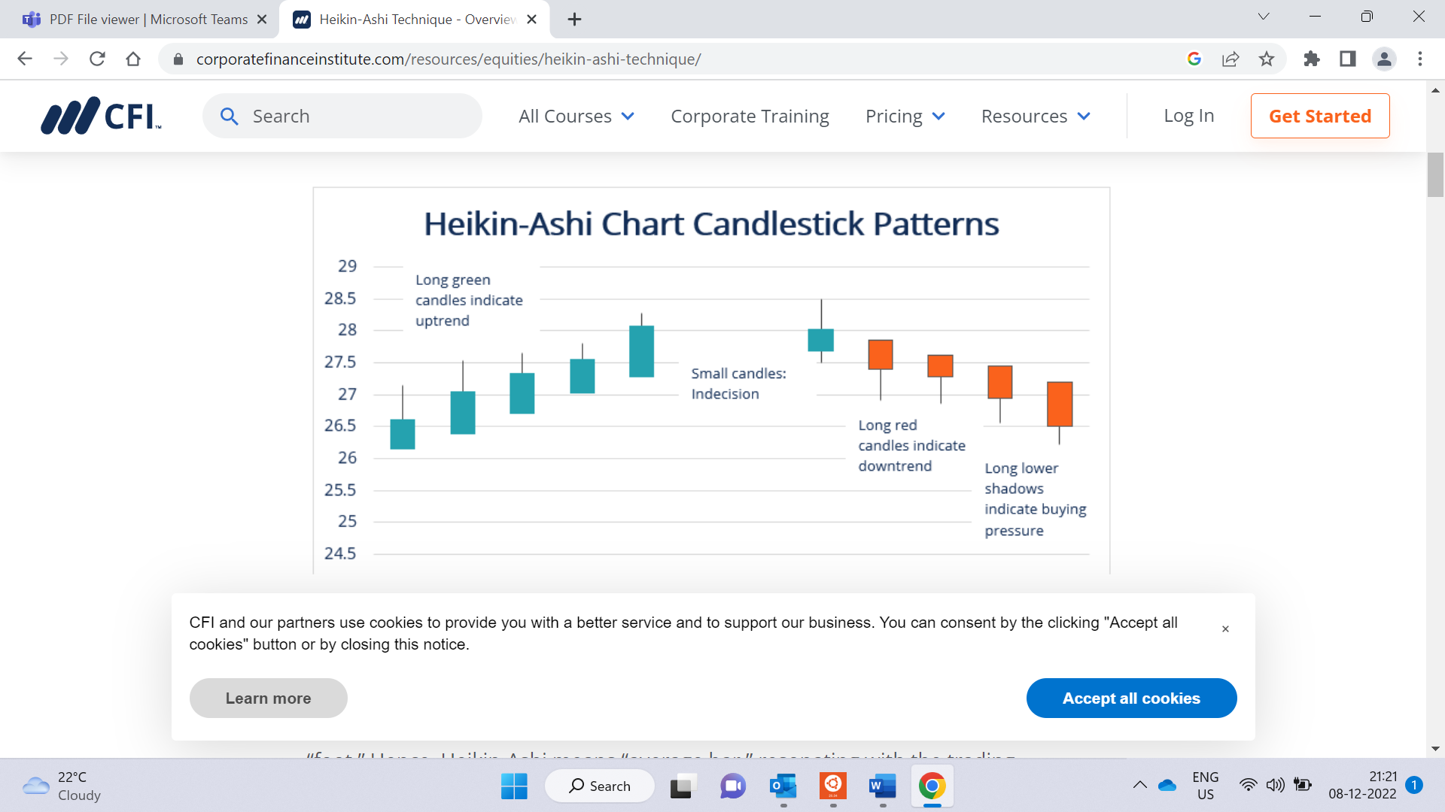

Slide 11
FLOW CHART

Slide 12
FLOWCHART
Start
User Enters into the Application
Display Stocks
Choose Stocks
Recommendation
R-G
G-R
Buy
Hold
Sell

Slide 13
HLD-LLD DIAGRAMS

Slide 14
LOW LEVEL DIAGRAM
Stocks
Technical Analysis Stock Screener
R-G
Buy
Stocks
List of Stocks
G-R
Sell
Hold

Slide 15
HIGH LEVEL DIAGRAM
List of Stocks
Choose Stock
Calculate using heikin ashi
Enter in Application
Technical Analysis Stock
Diagram
User
List of Stocks
R-G
Buy
Stocks
Recommended
G-R
Sell
Hold

Slide 16
SYSTEM ARCHITECTURE

Slide 17
SYSTEM ARCHITECTURE
start
user
Create
Stock details
Such as stock id, stock name,
Stock low,
Stock high, stock volume
Append and update stock details up to 20 stocks and display
Recommend to buy or sell based on Heikin Ashi candle stick colour changing pattern

Slide 18
FUNCTION DESCRIPTION
void create(): Given the stock details as input like stock_Id,stock_name,stock_open,stock_prevclose,stock_low,stock_high,stock_volume.
void display(): This function is used to Display all the stock details which given as input.
void append(): This function is use to add extra stocks.
void update(): This function is used to update the stock values.
void delete_rec(): This function is used to delete the stock values.

Slide 19
CODING AND EXECUTION

Slide 20
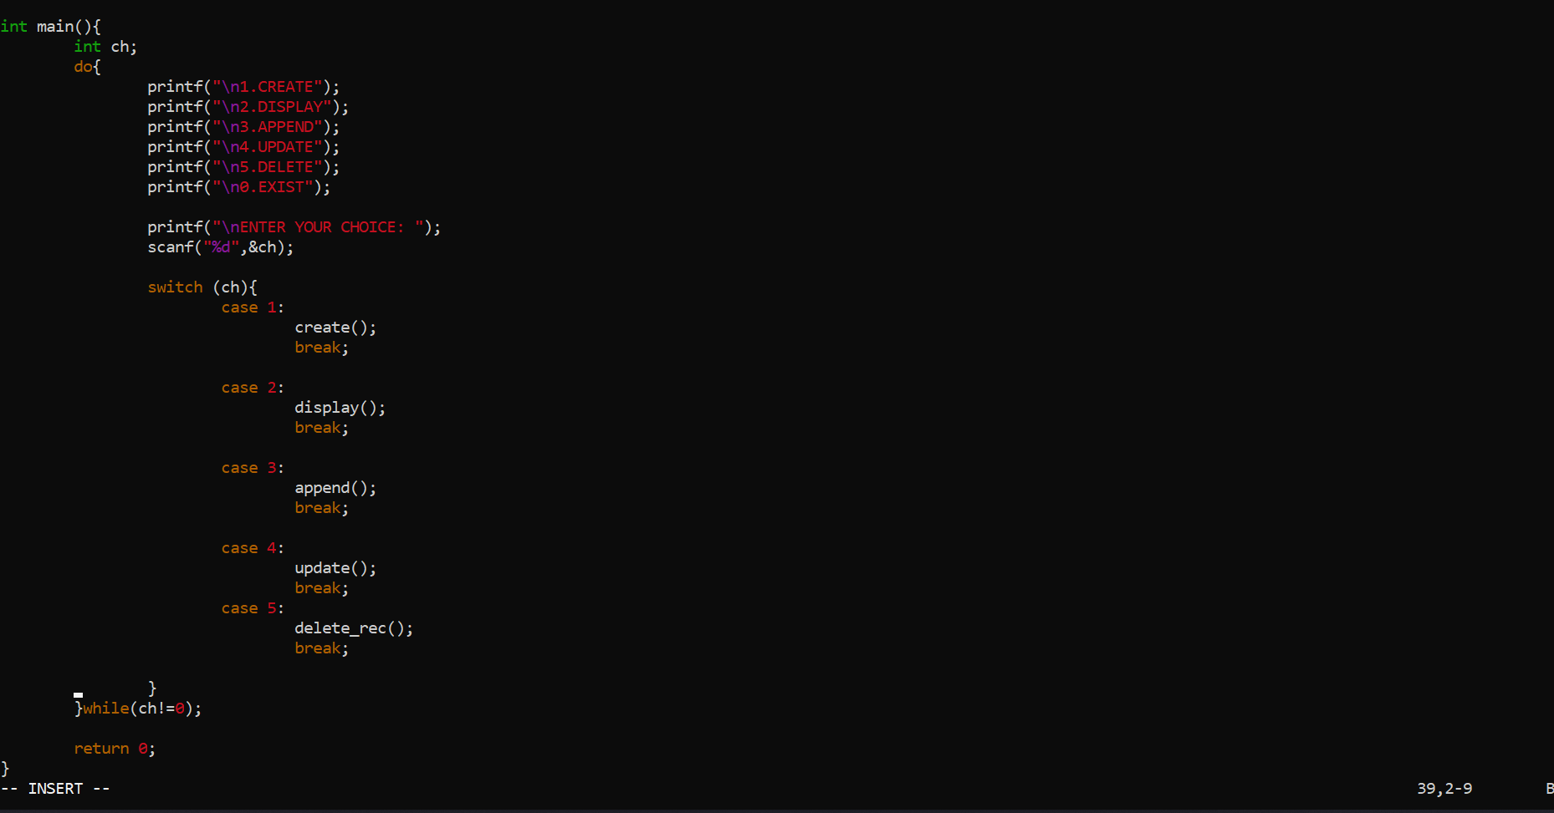
CODING AND EXECUTION

Slide 21
STOCK OPERATIONS
Create Stocks
Display Stocks
Add Stocks
Update Stocks
Delete Stocks

Slide 22
INTEGRATION TESTING AND UNIT TESTING

Slide 23
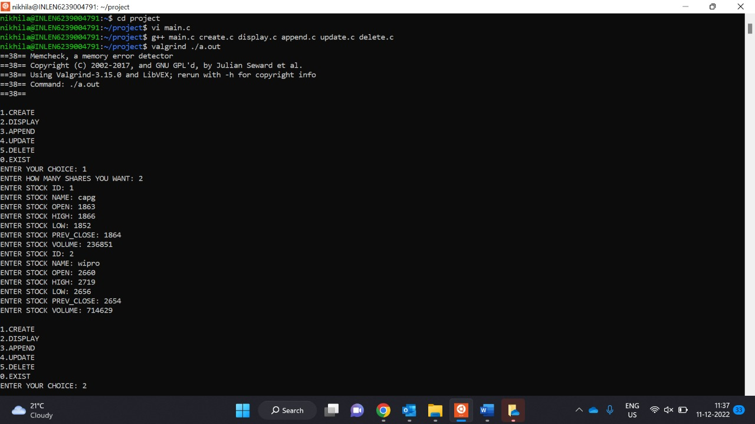
CREATE STOCKS OUPUT

Slide 24
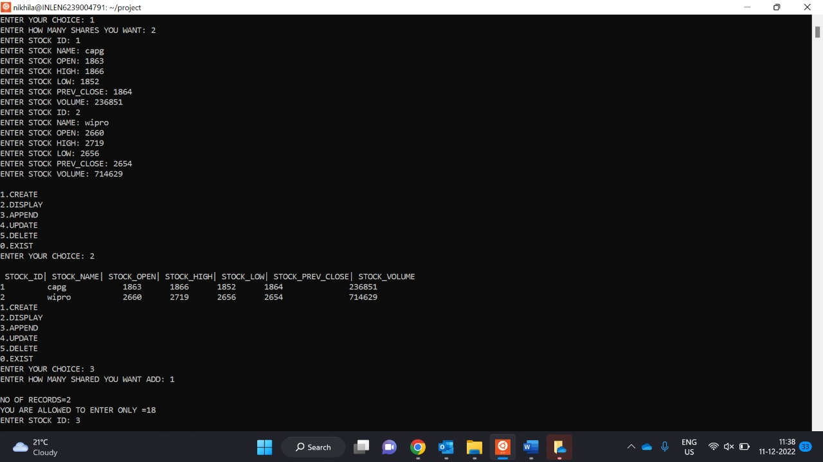
DISPLAY STOCKS OUTPUT

Slide 25
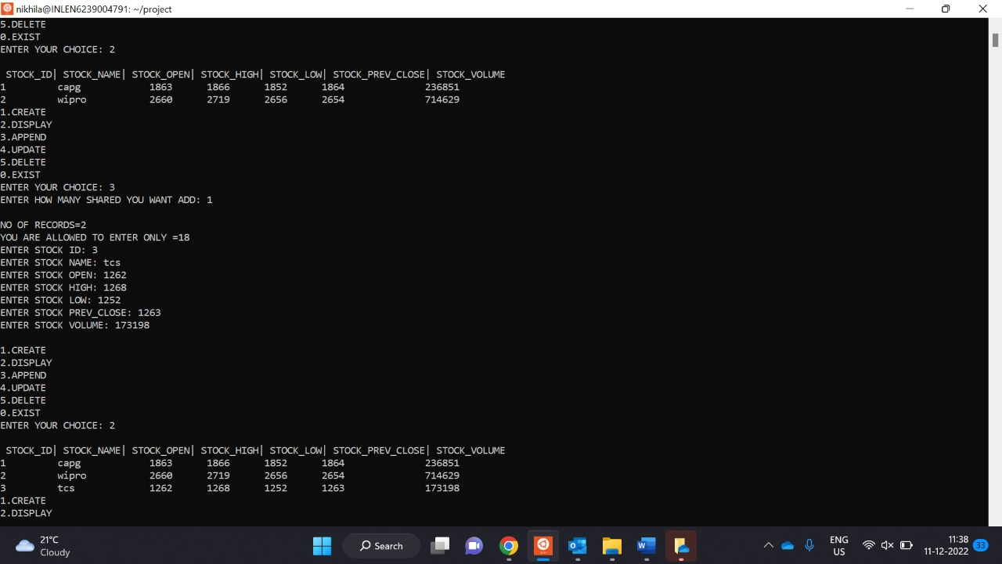
APPEND STOCKS OUTPUT

Slide 26
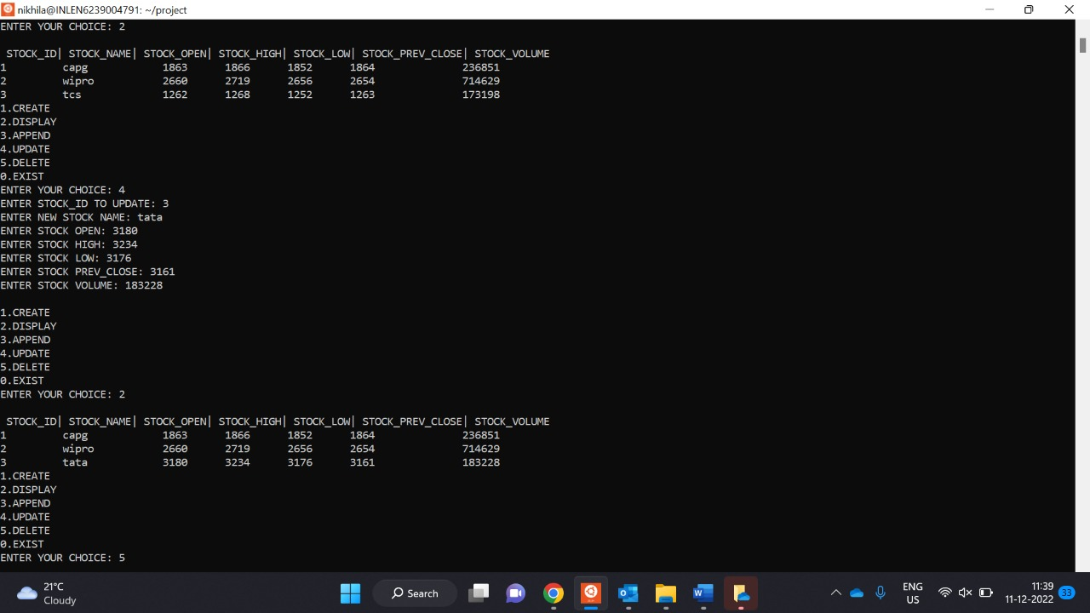
UPDATE STOCKS OUTPUT

Slide 27
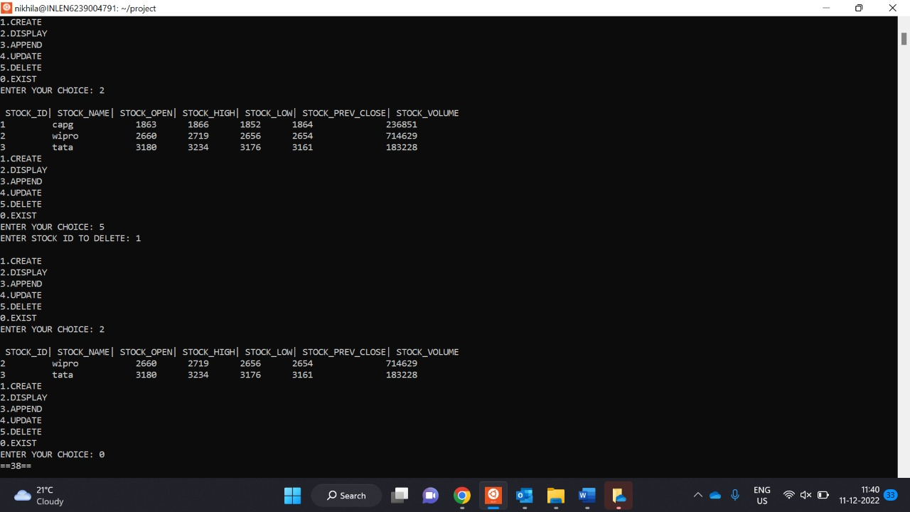
DELETE STOCKS OUTPUT

Slide 28
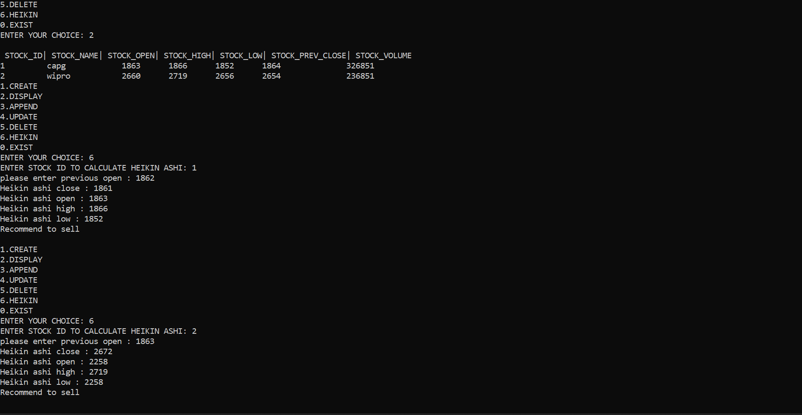
HEIKIN ASHI

Slide 29
TOOLS REPORT

Slide 30
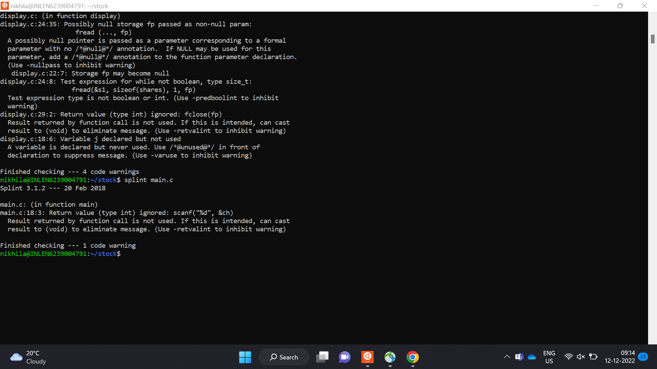
SPLINT REPORT

Slide 31
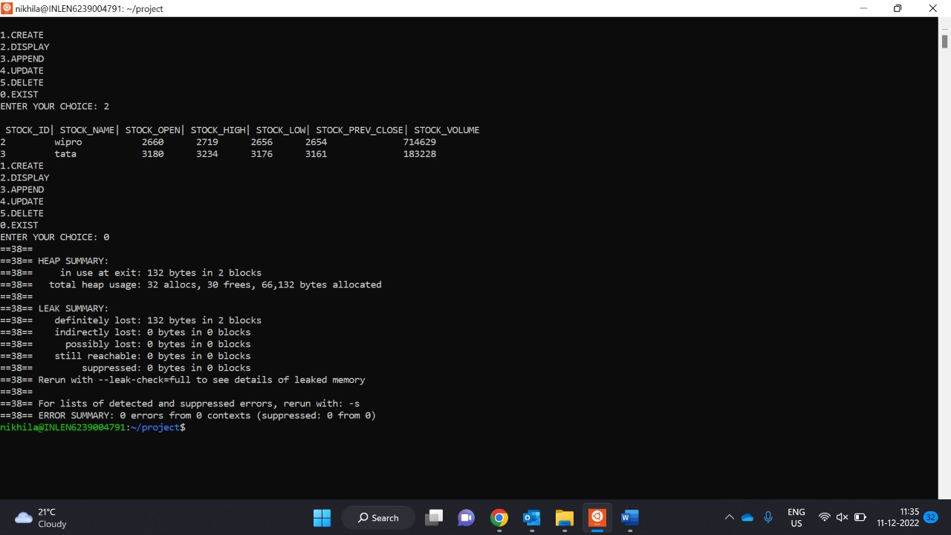
VALGRIND REPORT

Slide 32
OBSTACLES

Slide 33
OBSTACLES
Working with Splint and Valgrind
Understanding heikinashi technique

Slide 34
CONCLUSION
Successfully completed the coding and testing phases as per the given problem statement.
In this project stock details are created and operations are performed.
With the help of technical analysis screener, people are recommended to buy/sell stocks using algorithm of HeikinAshi Candle stick colour changing pattern .

Slide 35


